Slide 1


Krishnanand A
UST

Slide 2
Problem Statement
Design and implement a comprehensive data pipeline that efficiently ingests data from multiple heterogeneous sources, transforms and analyzes it using PySpark and Spark SQL in Databricks, and visualizes the resulting insights within Databricks and
Insightful analysis on Uber / Lyft Cab Prices and Weather Impact on Surcharge.

Slide 3
Details of Input Data
Cabs Data ( Uber and Lyft taxi prices during the week of November-December 2018 )
10 columns and 693,070 rows
Column title | Description
distance | distance between source and destination
cab_type | Uber or Lyft
time_stamp | epoch time when data was queried
destination | destination of the ride
source | the starting point of the ride
price | price estimate for the ride in USD
surge_multiplier | the multiplier by which price was increased, default 1
id | unique identifier
product_id | uber/lyft identifier for cab-type
name | Visible type of the cab eg: Uber Pool, UberXL

Slide 4
Details of Input Data
Weather Data
8 columns and 6,275 rows
Column title | Description
temp | Temperature in F
location | Location name
clouds | Clouds
pressure | pressure in mb
rain | rain in inches for the last hr
time_stamp | epoch time when row data was collected
humidity | thumidity in %
wind | wind speed in mph

Slide 5






Tech Stack Used
Azure Data Factory
Azure DataBricks
Azure CosmosDb
Azure Storage
PySpark
SparkSQL

Slide 6

Objectives
Data Extraction: Ingest data from multiple sources using Azure Data Factory.
Landing Zone: Store raw data in a NoSQL database (e.g., Azure Cosmos DB).
Data Transformation: Use PySpark in Databricks for data cleaning, transformation, and enrichment.
Materialized Views: Create SQL-based materialized views for efficient querying and analysis.
Visualization: Develop a thin visualization layer using Power BI to present the materialized views.
Completion status

Slide 7
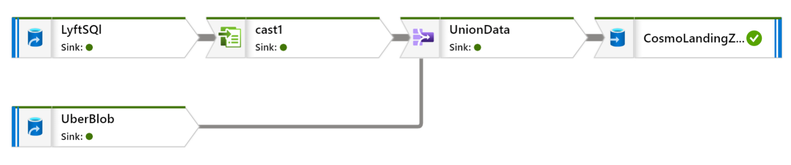
Solution Flow diagram
Data Flow

Slide 8
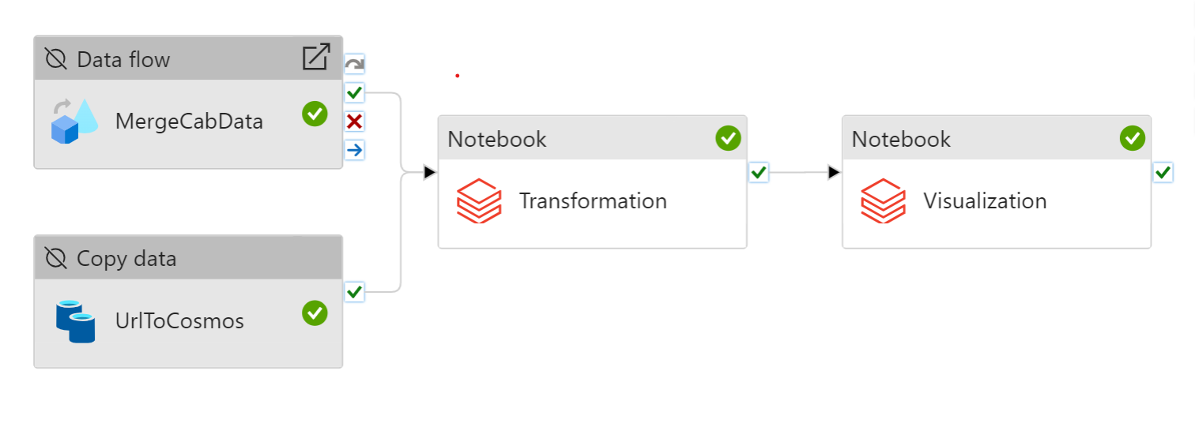
Solution Flow diagram
Azure Data Factory Pipeline

Slide 9
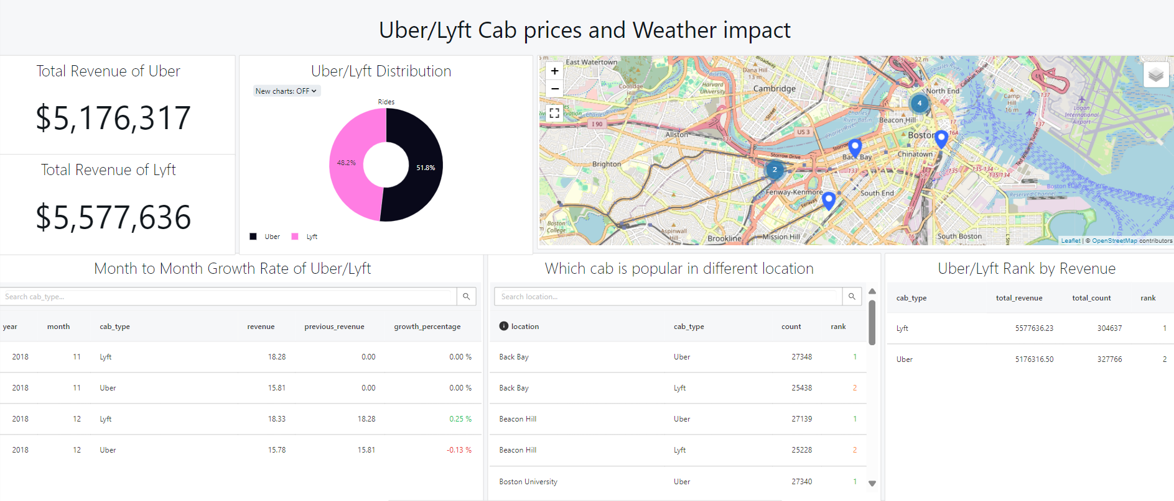
Reports/ Details of the output
Databricks Dashboard

Slide 10
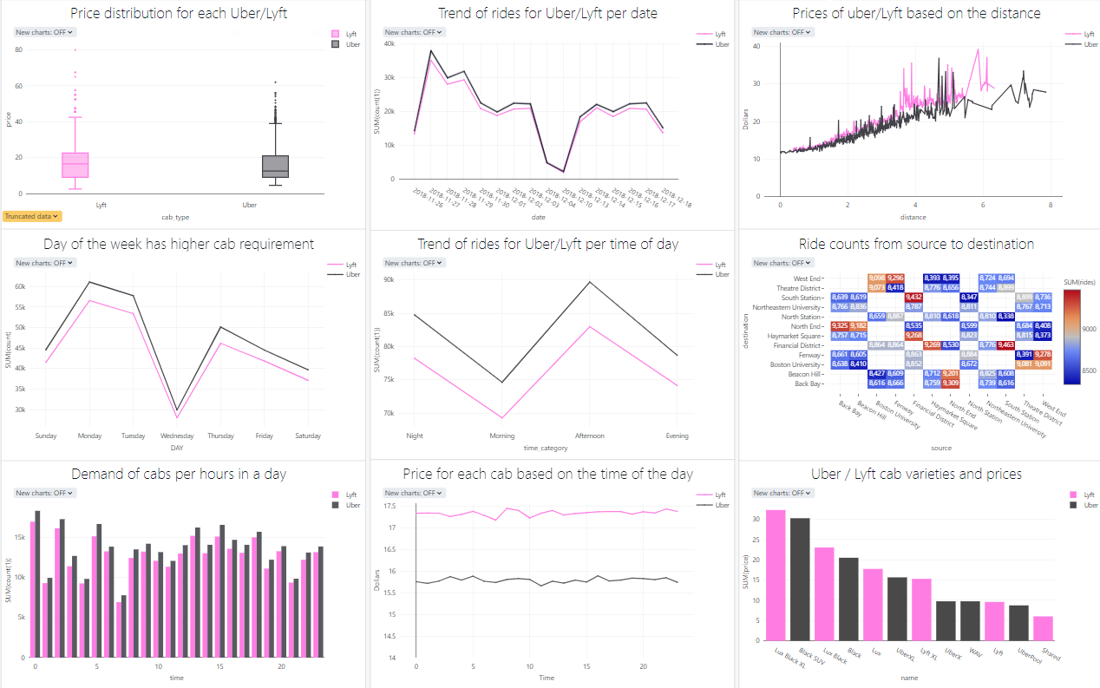

Slide 11
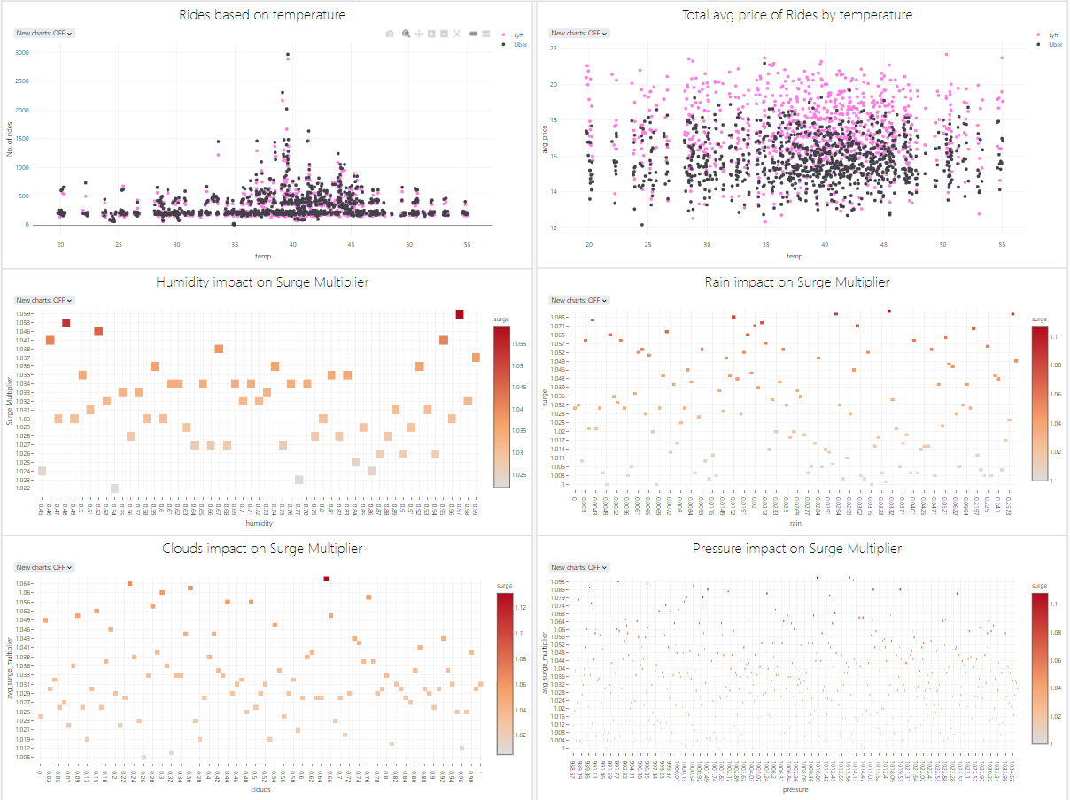

Slide 12
Solution Benefits
Insights
From the analysis It has came to understand that Uber is having more rides on Nov-Oct 2018
But Lyft has produced more revenue on Nov - Oct 2018
This can be because of the variations in the prices of cab services, Lyft charges more than Uber and Lyft charges less for their shared services.
Lyft has made a growth of .25% from Nov – Oct, Same time Uber has a loss of - 0.13 %
The Most common route is Financial District to South Station
The surge multiplier is also impacting the high revenue of Lyft, since the Uber has a constant surge multiplier of 1
While finding the relation between surge multiplier and different weather types the data has shown no relation between them

Slide 13
Challenges faced
Data flow task has inserted some data fields as integer to the cosmos DB even though the data is specified to be decimal, which enforced to re ingest the data which took lot of time

Slide 14
Conclusion
In conclusion, this capstone project successfully demonstrates the creation of a comprehensive data pipeline for Data Engineering and Analytics using Azure Data Factory and Databricks. We utilized Azure Data Factory for efficient data ingestion, followed by data transformation and analytics with PySpark and Spark SQL in Databricks. The architecture incorporated multiple data sources, a NoSQL landing zone, and SQL-based materialized views, culminating in a robust visualization layer within Databricks. By the end of the project, we established a functional pipeline that delivers valuable insights, showcasing the effectiveness of modern data engineering practices

